Slide 1
HOSPITALS IN HYDERABAD
CAPSTONE PROJECT - COURSERA

Slide 2
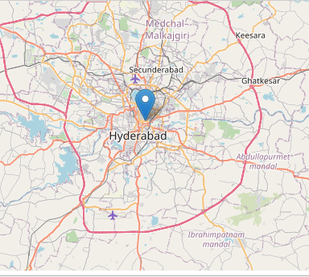
INTRODUCTION
Hospitals have become a major part of our society.
Many people are relying on hospitals these days
With increasing population in the world ,there is also a need of more hospitals
People want to choose a best hospital for them depending on whatever needs they want.
This project will help you to look at the hospitals in hyderabad and choose the best using their ratings

Slide 3
Data Collecting
Foursquare API data :
Details of Hospitals in hyderabad have been collected using foursquare API . The data collected includes 'categories', 'hasPerk', 'id', 'location.address', 'location.cc’ , 'location.city', 'location.country', 'location.crossStreet’, 'location.distance', 'location.formattedAddress' , 'location.labeledLatLngs', 'location.lat', 'location.lng', 'location.postalCode', 'location.state', 'name', 'referralId'
Data set :
I have created my own dataset for the hospitals I got in foursquare API .The data includes ‘Name’ , ’Address’ , ’ratings’ , ’contact details’

Slide 4
Data cleaning
Data collected from foursquare APi includes some unwanted and incomplete data
I have dropped some unwanted columns from the API data
There are some incomplete data for some hospitals ,I have removed that hospitals from the data
When it comes to data set , I have collected data from scratch so there was no need of data cleaning for new dataset.
After cleaning the data , merged the both dataset and made a new data data set for analysis

Slide 5
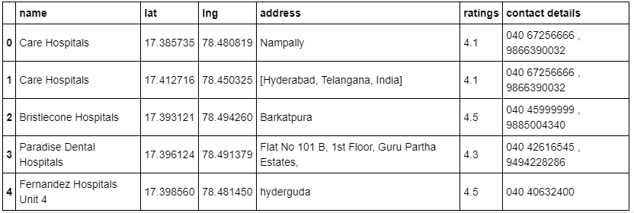
New data set
The new dataset (after merging of API data and dataset ) includes :
'name', 'lat', 'lng', 'address_x', 'formattedaddress', 'address_y', 'ratings', 'contact details'
Here also there are some unwanted columns which i have dropped
Now the new data set looks like

Slide 6
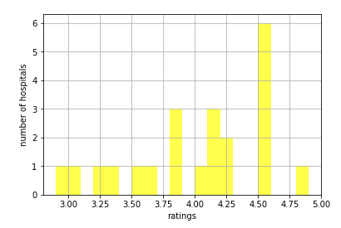
Analysis
Usings ‘ratings’ as keyword I have analysed the data and divided them into 3 categories ,they are
ratings >= 4 - 13 hospitals
ratings >= 3 and < 4 - 8 hospitals
Ratings < 3 - 1 hospital
I have created 3 datasets with this division
I have plotted the data in a histogram so that we can tell how many hospitals are in a particular rating range

Slide 7
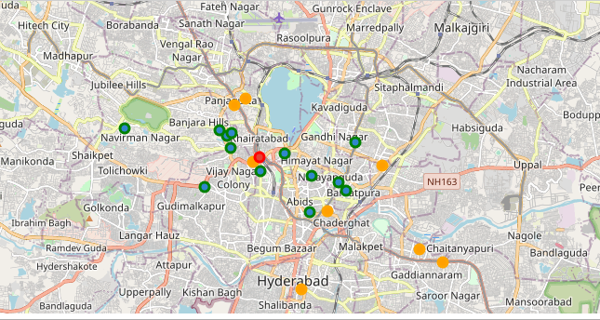
Visualisation
I have plotted the hospital data in map with 3 different colours for 3 different categories. Green - good
Yellow - average ,red - bad

Slide 8
Conclusion and future directions
The purpose of this project is to help a person in hyderabad who wants to search for a best hospital in his surroundings depending on the ratings of other people and get the contact details of the hospital he wants to visit .
The maps mentioned above will help users to choose the best hospital for him.
This analysis can be further used like :
We can make an app in which user can give their location and ratings they want and the app gives the best hospital using those parameters
We can also use this data for building a new hospital in a location where there are not much hospitals
THANK YOU

